Slide 1
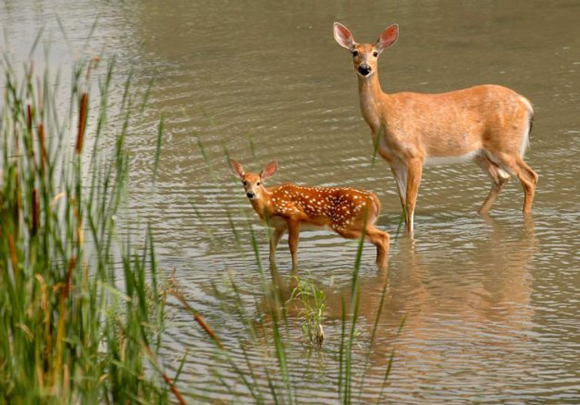

PEPPERMILL CHASE OWNERS ASSOCIATION
ANNUAL MEETING
April 26, 2023 | 7-8:30 pm | Bainbridge Library

Slide 2
Meeting Agenda
Call Meeting to Order
Introductions
Vote to approve 2022 minutes April 16, 2022 Meeting Minutes
Budget Review
Resolutions & Ballot for 2023
Collect Proxies
Declaration of Restrictions Review
Lakes Update & Question/Answer Session
Next Steps Recap
Adjourn Meeting
Quick Links on website
PeppermillChase.com
Financial Reports >
Annual Meetings >
Declaration of Restrictions >

Slide 3
Budget Report | 2022 Income & Expenses and 5 Year Financial Outlook

Slide 4
Resolutions and ballot for 2023
Resolution 1: 2023 proposed budget approval
Resolved that the proposed budget for 2023 prepared and submitted by John Blatt to the
Peppermill Chase Owner’s Association hereby is approved and adopted as the budget
for fiscal year 2023.
Nominations for Board of Trustees
Resolution 2: Election of Board of Trustee members
Resolved that the candidates with the most votes are declared to have been and are duly elected to serve a two-year term commencing April 2023 on the Board of Trustees of Peppermill Chase Owners Association. There are three (3) open board positions.
Please vote for up to 3 candidates.
Candidates | Yes | No
Rob Coppenhaver
Mary Beth Lindner
Write in Candidate
Yes | No

Slide 5
Declarations of Restrictions | Discussion Points for Feedback
Over 30 years, no changes…time for an update…
The Board has been working to update the original Declaration of Restrictions for the community that were established in 1990. The Board’s goal is for the Declaration of Restrictions to better reflect current Ohio law, provide clarity on a variety of community topics, and to address future needs of the community. The Board has worked with the Association’s attorney, Michael Lamana, through the revision process. HOA best practices and the results of the 2021 community survey have guided the Board’s efforts.
In addition to the Declarations, changes to the PCOA Bylaws will also need to be amended for consistency purposes. Accordingly, the Board will be making changes to the Bylaws based upon feedback from the community regarding the proposed changes to the Declarations

Slide 6
Declarations of Restrictions | Discussion Points for Feedback
Discussion points…
Modify to conform to changes in Ohio Law.
Simplify assessment provisions and allow the Board to set annual assessments at a rate that does not revert back to an earlier assessments figure after three years.
Allow the community to build a special reserve to minimize financial impacts for planned capital improvements or unforeseen capital expenses rather than seek a special assessment in a single year for a capital improvement or an emergency situation.
Exploring modifications to the quorum requirement that encourage participation and discourage inaction among homeowners.
Remove all references to developer/builder.

Slide 7
Declarations of Restrictions
Timing and Logistics
The Board intends to hold virtual meetings over the coming months to dive deeper into the proposed changes, get your feedback, and answer any questions.
A date on which to vote on the revised Declarations will depend on the feedback from these virtual sessions. Once put to a vote, approval by at least 75% of the community is required for the new declarations to be approved and recorded with the County.
Changes to the PCOA Bylaws will also need to be amended in the future.
  Board will be making changes to the Bylaws based upon feedback from the community.
Following is a high-level overview of some of the proposed changes to the Declarations.

Slide 8
Proposed Changes to the Declarations
Examples of Proposed Changes | Discussion Points for Feedback
Article III: Elimination of classes as it relates to voting rights:
The original Declarations established voting classes in which Class A (homeowners) members were entitled to one votes per lot while Class B (developer) members were entitled to three votes per lot, until Class A votes outweighed that of Class B. The developer no longer owns any lots in the subdivision, so references to the developer owning lots and distinguishing between classes of votes has been eliminated.
Article III: Changes to quorum requirements for Member Action:
The original Declarations established a quorum requirement of 60% participation (26 out of 43 homes) for voting on any Member Action.
We are proposing a quorum reduction of 10% on any vote if the original quorum requirement was not met in order for the Board to move matters forward in the absence of community participation. For example, if the Action being voted on requires a 60% quorum and that participation level is not reached, a subsequent vote requiring 50% participation may be raised so long as the subsequent vote occurs within 90 days of the prior vote.

Slide 9
Proposed Changes to the Declarations
Article V: Assessments:
Establishment of reserves
  The original Declarations did not outline any means by which the Association may establish a reserve fund even though the Bylaws allow for such.
  Changes to Ohio law and HOA best practices have made it necessary to add language regarding the establishment of reserves and the purpose and use of such funds.
Annual dues
  Elimination of the three-year sunset provision in the original Declarations (whereby annual assessment reverts back to original $200 amount from 1990 if not otherwise voted on by the Members).
  The level of the Annual Dues will be in effect until such time as the Association votes to raise or lower the dues.

Slide 10
Proposed Changes to the Declarations
Article V: Assessments:
Special Assessments
  The original Declarations required that any levied Special Assessment must be used in that assessment year. The revision eliminates that provision to allow for the Association to plan for future community needs and build a necessary reserve fund over time.
  Additional clarity on allocation for capital improvements for the lakes, in which the lake lots would be responsible for twice the amount of an assessment for lake-specific assessments.
  Establishment of Special Assessments for Unexpected Costs or Expenses in the Declarations in which the Trustees may levy up to $20,000 from the community for such Cost or Expense without the vote of the Members. Only the Bylaws currently address similar expenses at a $8000 threshold without vote of the community.

Slide 11
Proposed Changes to the Declarations
Article VI: Covenants and Restrictions
  Prohibited leases Establishment of provisions around short- and long-term leases is being proposed in which the duration and frequency of leases is clarified.
      No more than four short-term (1-6 months) leases in any three-calendar year period.
      No more than three long-term (>6 months) leases in any three-calendar year period.
  Further detail and clarity on obligations of the owner, hardship provisions, damages, etc.
  Establish rules around allowable animals and pets.
  Updated clarity on mailbox and street light guidelines.
  Parking and temporary repair of vehicles, boats, and personal motorized vehicles
      Limiting the duration to park or store any of the above mentioned vehicles to ten days within any consecutive three-month period, unless kept in an enclosed structure.
  Establish and clarify guidelines on allowable signage in front yards.
  Limiting construction and landscaping noise to 7AM – 8PM, Monday – Friday, and 8AM – 8PM on Saturday and Sunday.
  Prohibited homeownership in the community by any registered sex offenders.

Slide 12
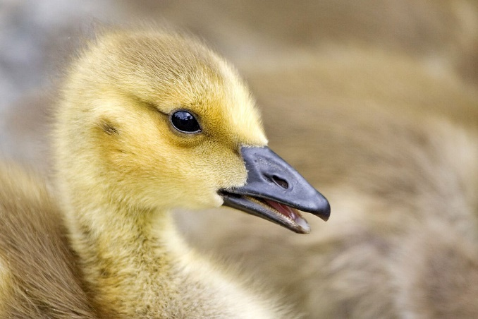
Lakes Update
Question/Answer Session
Next Steps Recap
Adjourn Meeting
Additional comments & feedback: pcoafeedback@gmail.com

